Slide 1



Radiometric simulation of LADAR imaging for underwater environments
UPC – MSc Photonics
Thomas R. Morris II
Advisor Dr. Santiago Royo

Slide 2
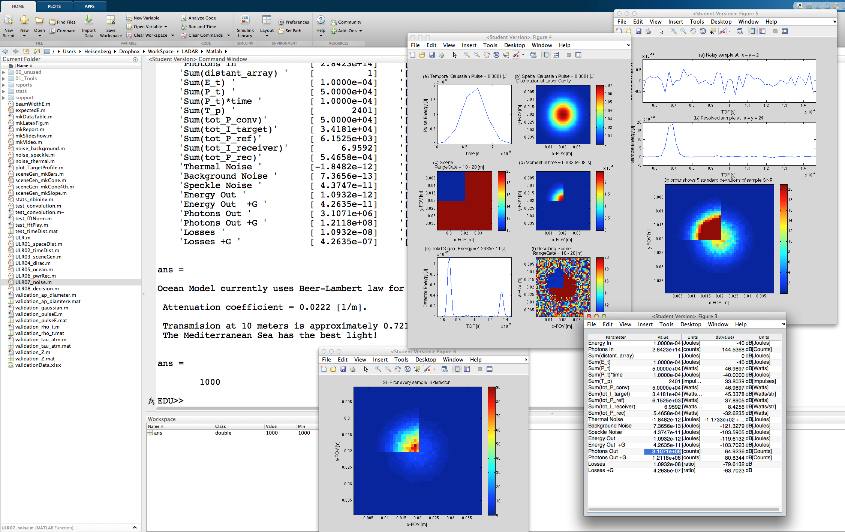
Abstract
LADAR Radiometry
Engineering Tool
Matlab Framework
Theoretical Description
Validation
Examples of Use
.

Slide 3
Outline
Motivation
-Description of LADAR systems
-Design need in underwater environments
Theoretical Discussion
-Range equation
-Spatial energy distribution
-Temporal energy distribution
-Attenuation in ambient media
Validation
-Example LADAR system
-Analytical vs. numerical calculation
Results
-Radiometric outcome of using the example system in three different environments

Slide 4
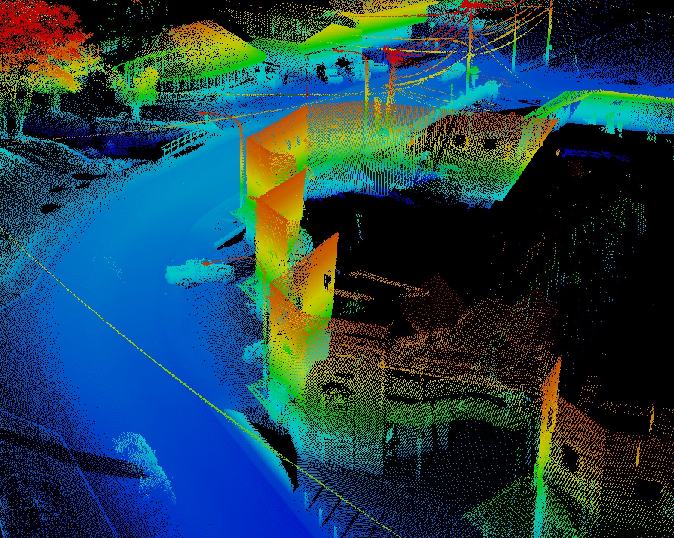
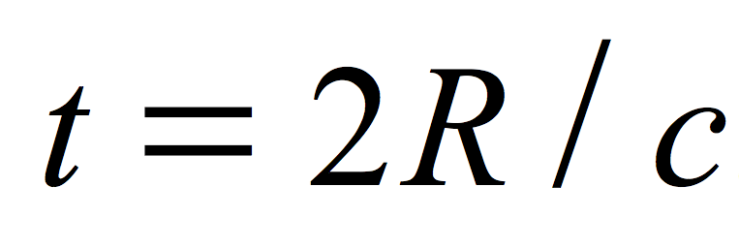
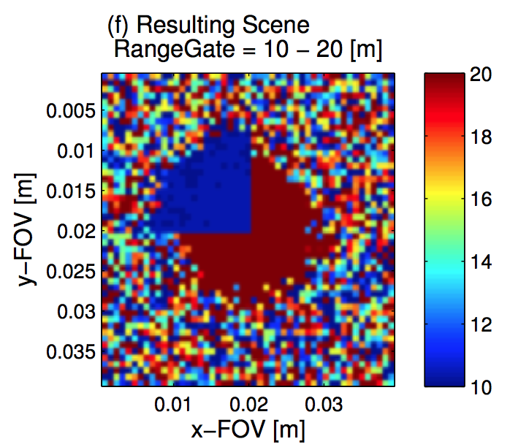
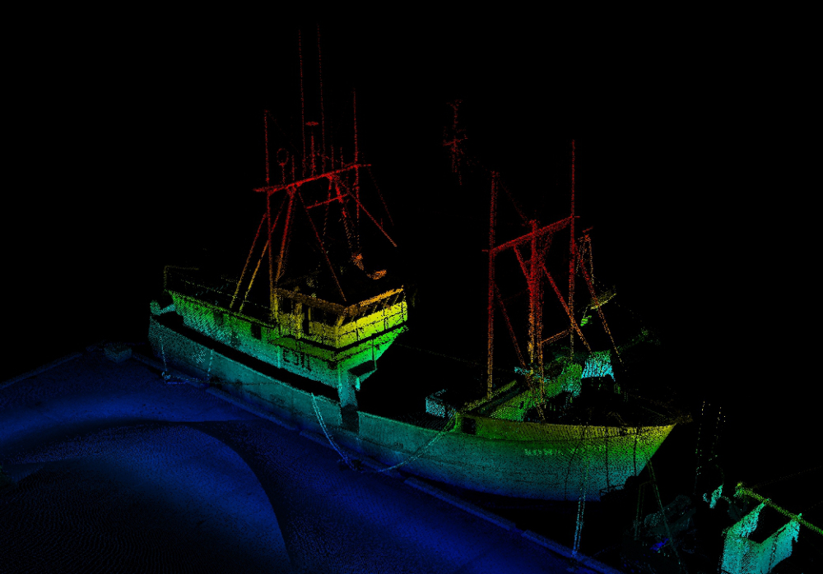
What is LADAR?
Laser Detection and Ranging (LADAR) is method of rendering 3D spatial information using the time-of-flight (TOF) that it takes a pulse of laser light to travel from the laser, reflect off a target, and return to a detector.
Time-of-Flight (TOF)
Single Point
Single laser and photodetector
Imaging
Single point system that scans
Photodetector array with single laser
(with and without scanning)
Multiple laser and detectors

Slide 5
Underwater LADAR Radiometry (ULR)
Engineering Motivation
Radiometry of LADAR
Tool for use during the design process
Educational Motivation
Specialty in rising technology
Radiometric aspect of remote sensing
Experience in Matlab environment
Using numerical methods for discrete calculations

Slide 6
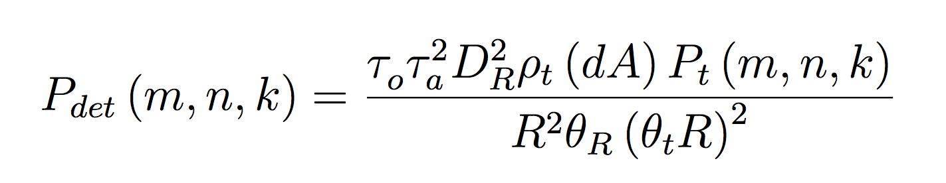
ULR - Theoretical
Range equation
Optical transmission
Ambient media transmission
Aperture diameter
Reflectivity
Area of FOV
Pulse power
Distance of surface
Divergence

Slide 7
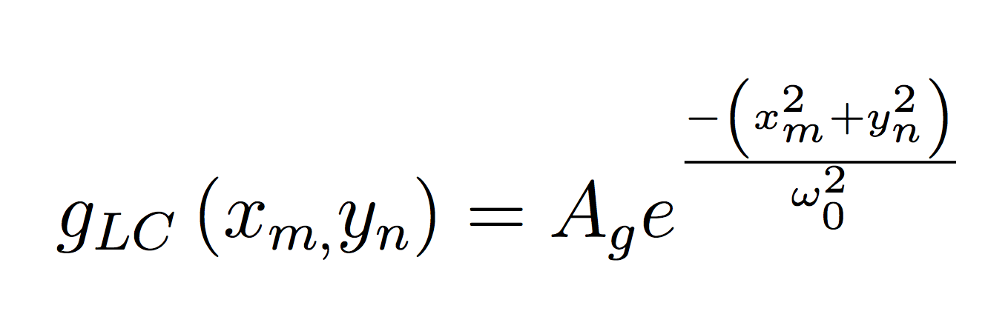
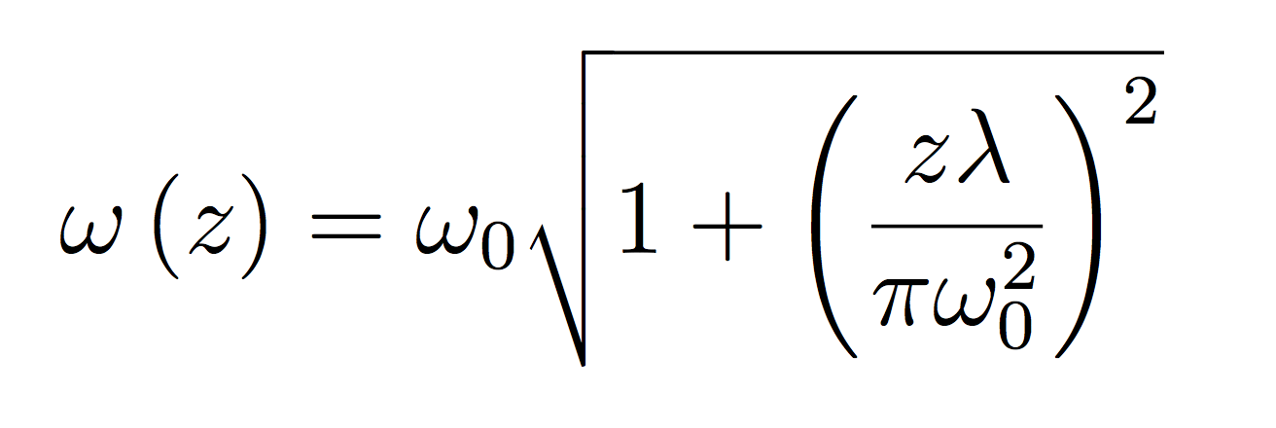
ULR - Theoretical
Spatial Distribution
Laser cavity Gaussian
Fundamental mode – TEM00
Spatial sampling in the photodetector array at m, n
Beam waist
Beam width function for distance z < Rayleigh length

Slide 8
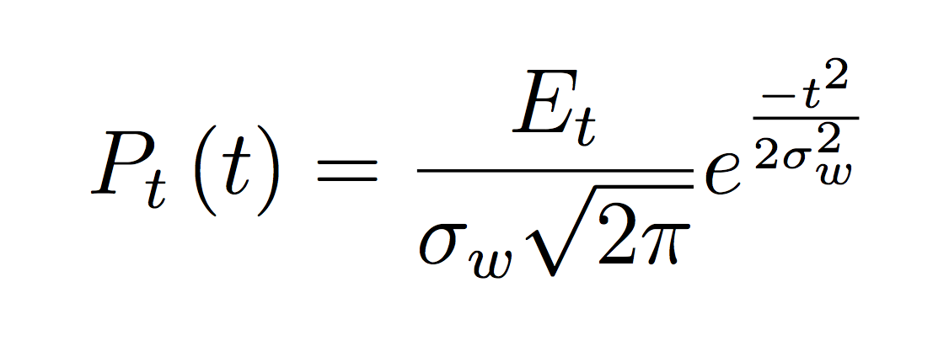
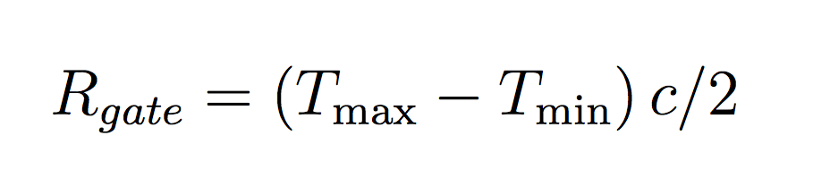
ULR - Theoretical
Temporal Distribution
Gaussian Distribution
Sampling ‘dt’ is set to the temporal standard deviation of the laser pulse, Sigma_w
The Range Gate is the expected range of distances where the scene will be located
The range gate corresponds to the start and stop time of the signal observation

Slide 9
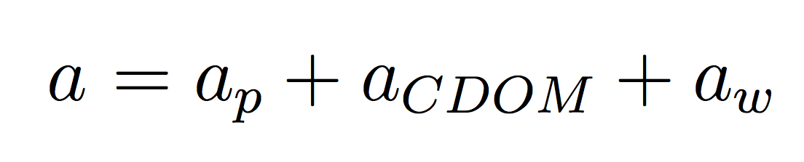
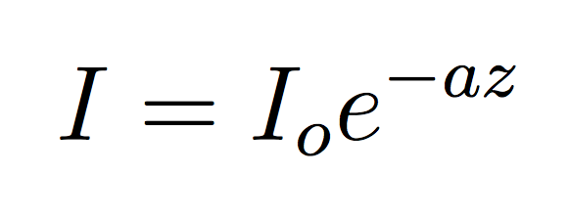
ULR - Transmission
Attenuation - the loss of signal caused by absorption and scattering of particles found in the ambient media.
Attenuation in ocean water
Particulates
Colored decaying organic matter
Absorption of water
Transmission of light is the fraction of the light that returns to the detector due to losses attenuation losses in the ambient media. Given by the Beer-Lambert law.
The optimal window for transmission in most oceans is around 550 nm

Slide 10
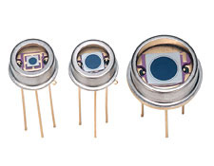
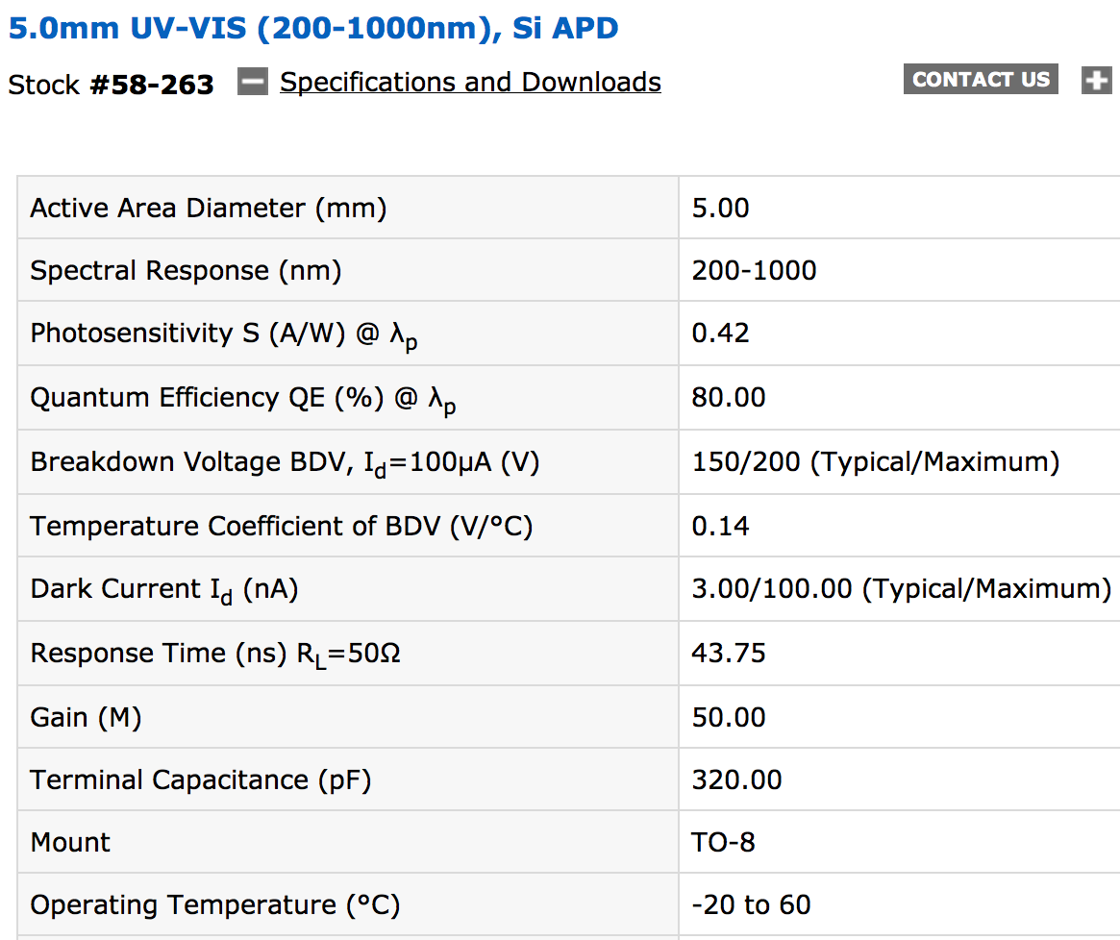
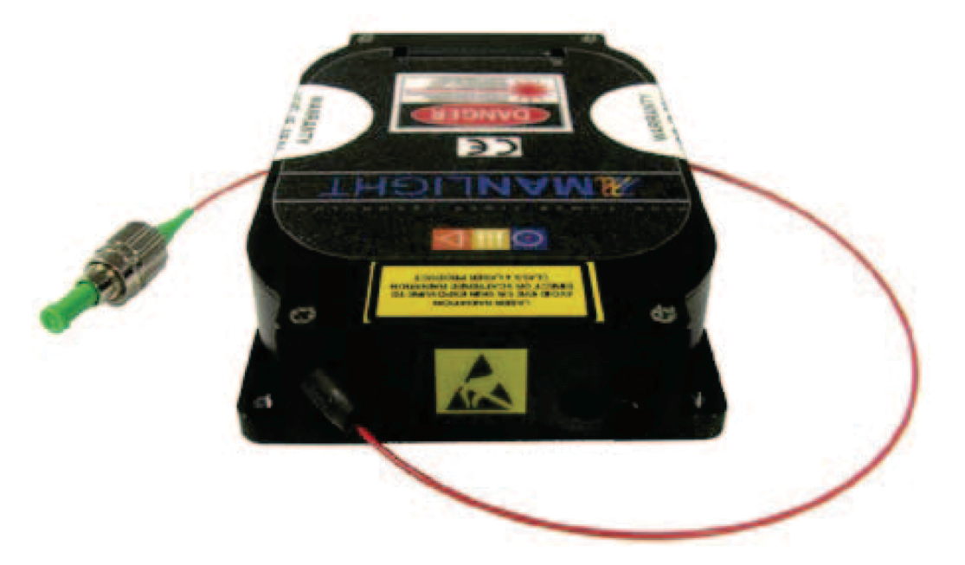
ULR – Example LADAR System
Avalanche Photodiode Array
Fiber laser module:
Currently in use at CD6
Downconvert to 550 nm
Pulse energy 0.0001 J
3sgroup.com
MLT-PL-R-OEM20 Series
edmundoptics.com

Slide 11
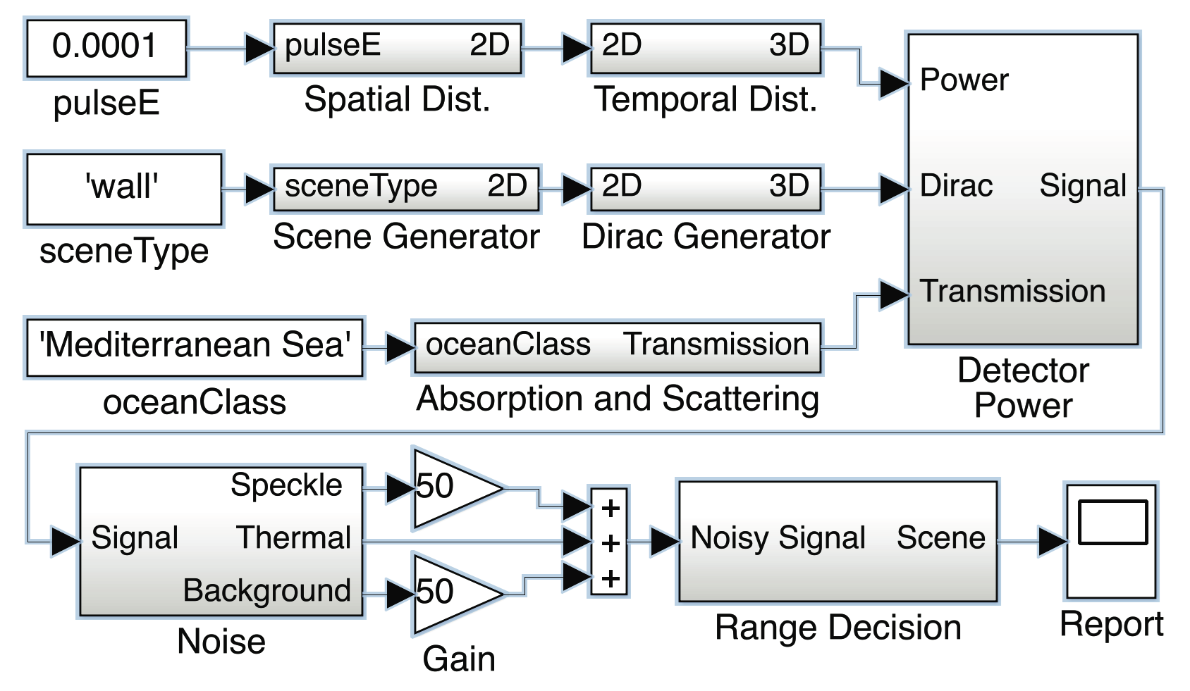
ULR – Structure of Code
pulseE, sceneType, oceanClass

Slide 12
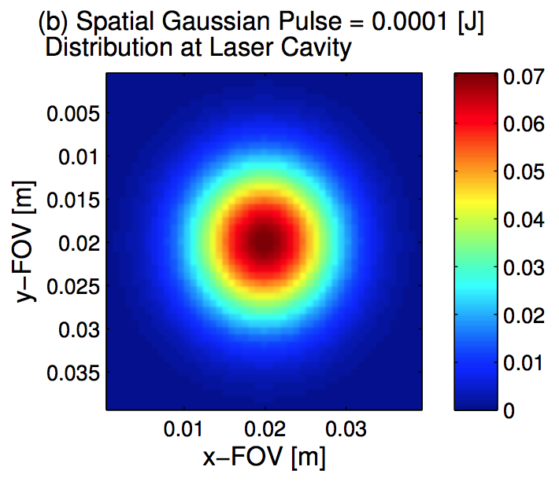
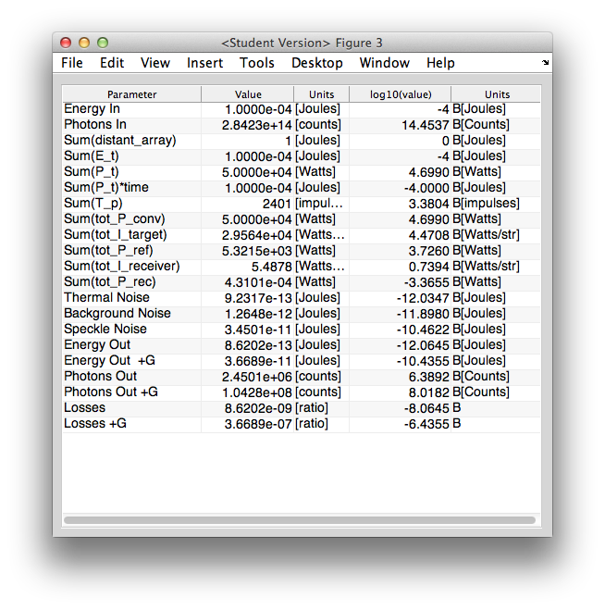
ULR – Spatial Distribution
Creates Gaussian distribution of laser energy in the 2D “distant_array” that is normalized and then scaled to the input energy, “pulseE”
1.00e-4 J
Radiometry Table

Slide 13
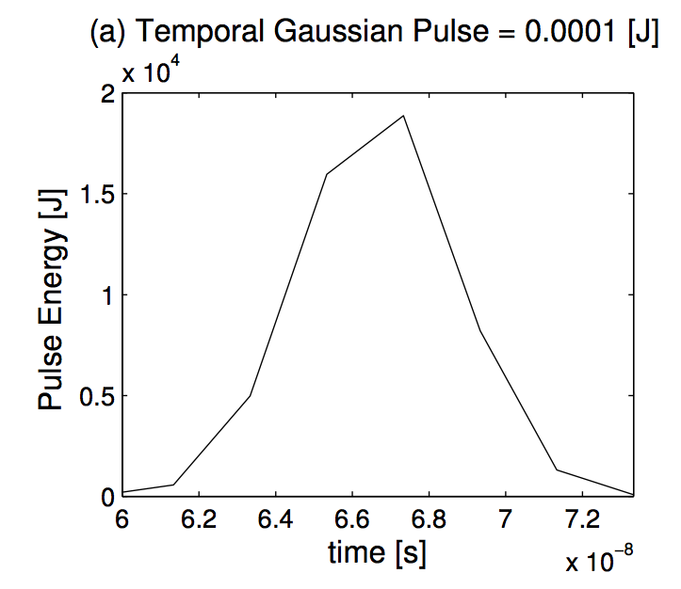
ULR – Temporal Distribution
Temporally expands the pulse energy contained in the 2D distant_array resulting in a 3D matrix of the pulse power.
Total Power
5.00e+4 W
1.00e-4 J
Total Energy
Radiometry Table

Slide 14
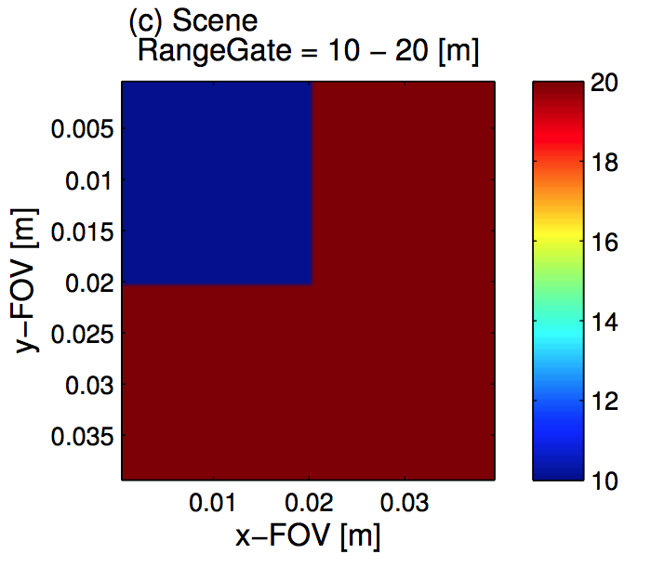
ULR – Scene generation
The observation scene is defined by one of several commands including wall, corner, square, slope, bars, cone, cone4th, etc.
It generates a normalized 2D array that is scaled by a user input and placed at a distance “Z” from the detector.

Slide 15
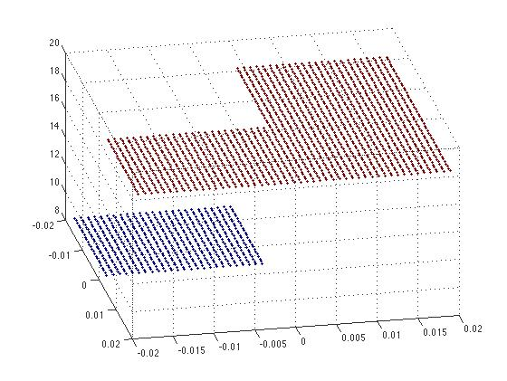
ULR - Dirac
In LADAR simulations, the Dirac function is called the Target Profile.
A 3D matrix of zeros is created, and the 2D scene array is used to assign Dirac impulses as the proper indices are set to one.
The number of impulses contained in the target profile is given in the radiometry table.
2401
Radiometry Table

Slide 16
ULR - Transmission
The transmission function selects a known attenuation coefficient for the specified body of water.
- It then applies the Beer-Lambert law to calculate the transmission values for each sample in the range gate.
- Output is a vector with the same dimensions as the range gate.

Slide 17
ULR - Range Equation
The power contained in the laser pulse is then convolved with the Dirac target profile to obtain the final temporal distribution of the laser energy.
The received power at the detector is then calculated using a for-loop to apply the range equation for each temporal sample of the photodetector array.
4.31e-4 W
Radiometry Table

Slide 18
Noise and Gain
Thermal Noise
Background noise is calculated according to the detector specifications and the solar irradiance of the environment.
Thermal noise is calculated based on the temperature of the detector.
Signal is contained by the speckle data. Since speckle can be compensated by time averaging techniques, it is adequate to run the simulation as incoherent light for radiometric purposes.
9.23e-13 J
Background
Noise
1.26e-12 J
Radiometry Table
Gain is applied to the signal and background noise before all three are added together.

Slide 19
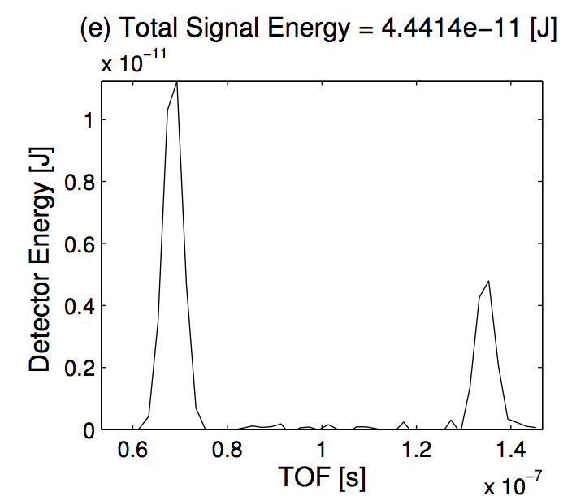
ULR – Scene Construction
The TOF for the maximum value in each time varying sample of the array is chosen for determining the range during scene reconstruction.
The integrated array energy vs. time is also useful radiometric tool.

Slide 20
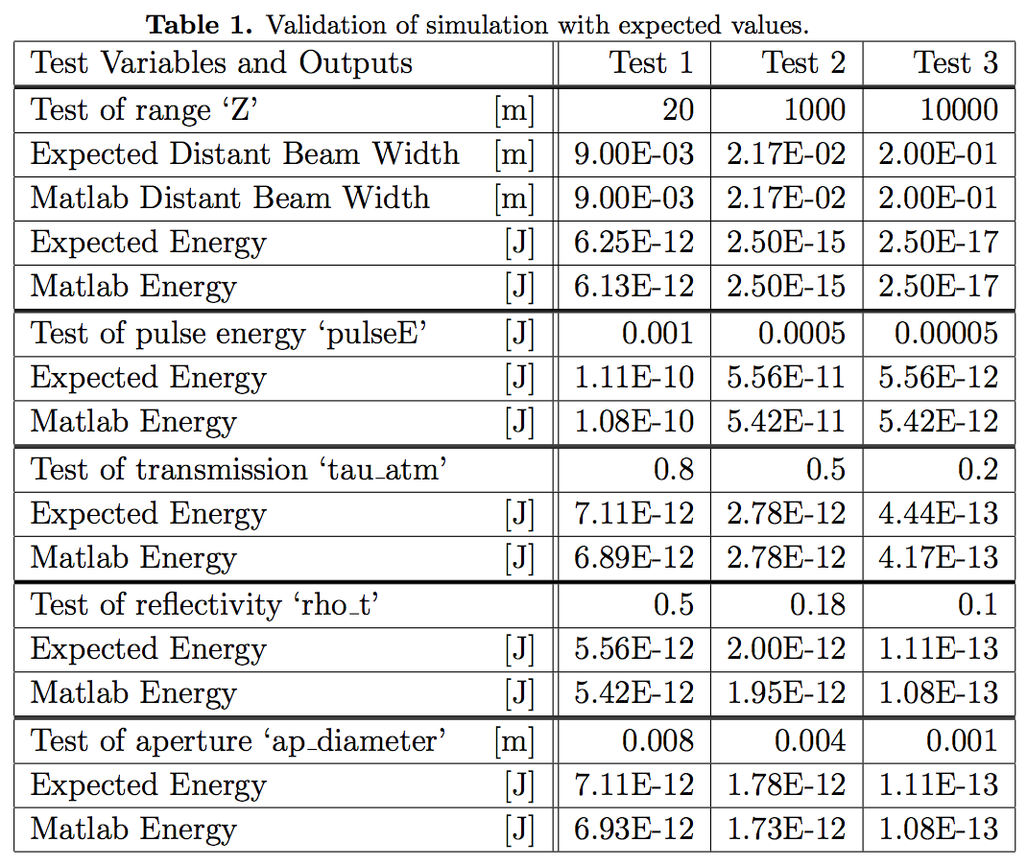
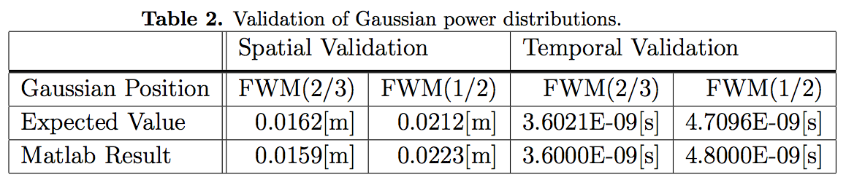
ULR - Validation
Matlab results were compared with the expected analytical values for both input variables
Spatial and Temporal Gaussian distributions were tested at the FWM(1/2), FWM(2/3)

Slide 21
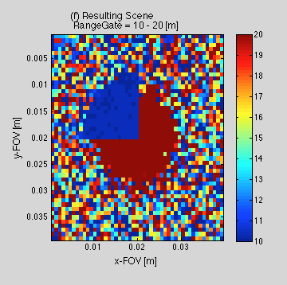
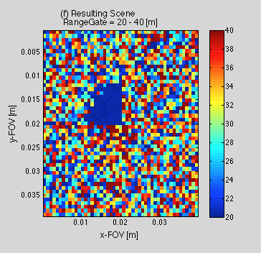
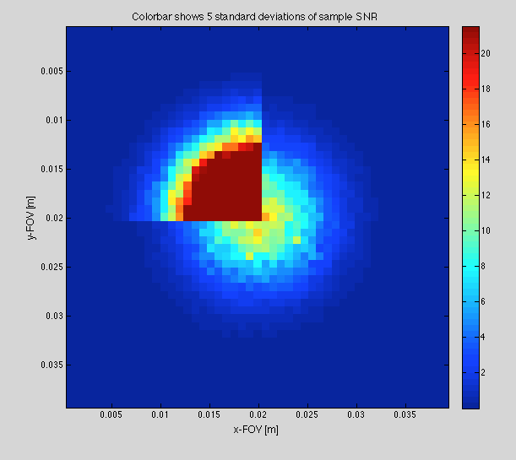
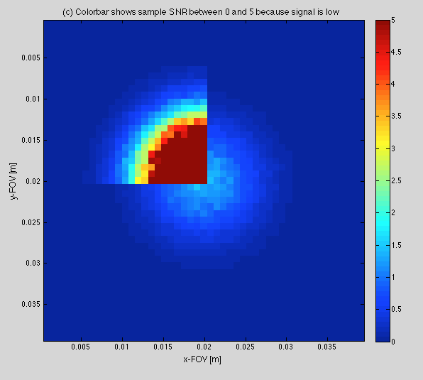
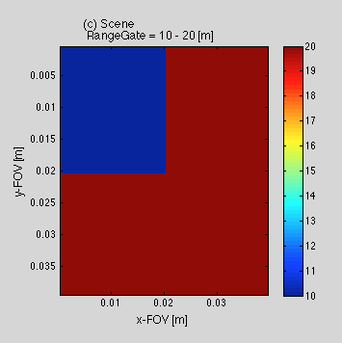
ULR – Thesis Scenario
Same LADAR system as example
The loss do to attenuation in the first scenario is -2.6dB = 45%
The additional loss when doubling the distance of the walls in the scene is -8.32dB = 84%
(a) 10 & 20 meters
(b) 20 & 40 meters
‘Corner’ Scene Type

Slide 22
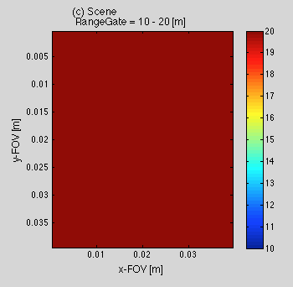
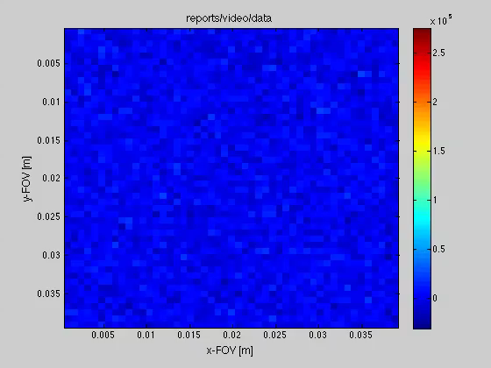
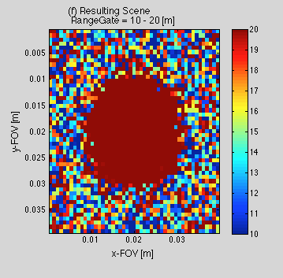
ULR – ‘Wall’ Scene Type

Slide 23
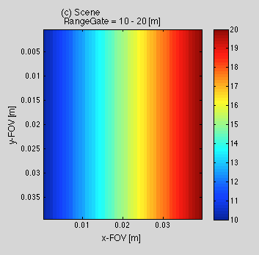
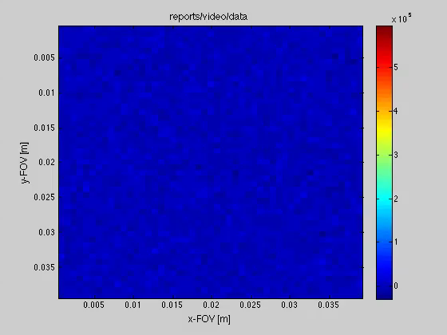
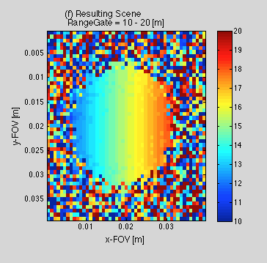
ULR – ‘Slope’ Scene Type

Slide 24
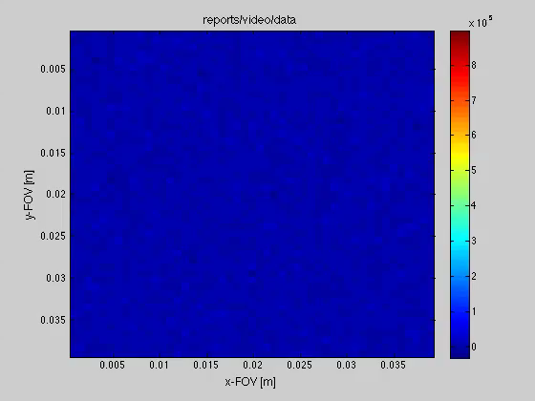
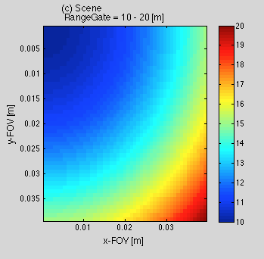
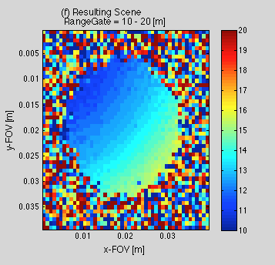
ULR – Cone4th Scene example

Slide 25
ULR - Conclusions
Radiometric Analysis
Engineering Tool
Matlab Framework
Useful for predicting LADAR behavior in underwater environments
Structure of Code
Validation
Examples of use

Slide 26
THANK YOU!

